Slide 1
Supervised Learning – Classification Techniques
Session - 4
Session3
Aakash Goel , https://www.linkedin.com/in/goelaakash123/
Acknowledgment: Presentation developed by Prof. Arun. and Modified by Aakash Goel

Slide 2
Agenda
1
Classification Algorithm
2
Steps
3
Case study

Slide 3

Machine Learning Algorithms

Slide 4
Agenda
Introduction
Data Acquisition
Data Description
Data Visualization
Data Normalization
Train-Test Split using Stratified Sampling
Backward Elimination
Hyperparameter Tuning using Randomized Search
Model Training
Model Evaluation
Confusion Matrix
Precision
Recall
ROC AUC
Optimal Threshold
Notes:
https://www.linkedin.com/pulse/100-open-source-big-data-ml-architecture-papers-sequel-anil-madan

Slide 5
Classification method
Supervised Learning: Focus on Classification
Importance in Manufacturing: Defect Detection, Quality
Control
Techniques Covered:
Logistic Regression
Decision Trees
Model Evaluation Metrics
Notes:
https://www.linkedin.com/pulse/100-open-source-big-data-ml-architecture-papers-sequel-anil-madan

Slide 6
Classification method
Data Acquisition
Using faker library to create synthetic data
Dataset features:
Temperature, Pressure, Humidity, Speed (Numerical)
Material (Categorical)
Defective (Binary Target)
Introduced correlation for realistic scenario
Notes:
https://www.linkedin.com/pulse/100-open-source-big-data-ml-architecture-papers-sequel-anil-madan

Slide 7
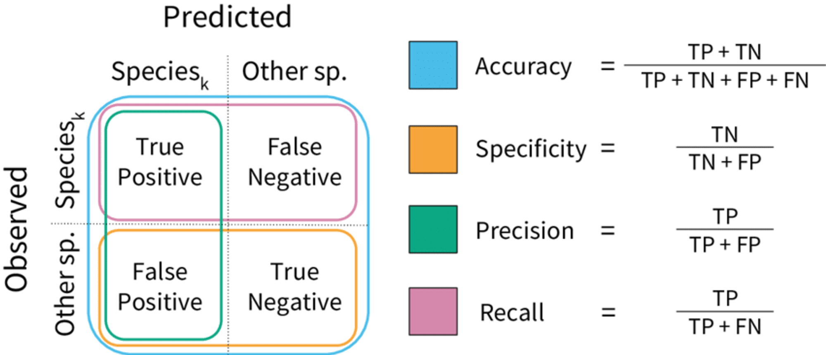
Classification method
Notes:
https://www.linkedin.com/pulse/100-open-source-big-data-ml-architecture-papers-sequel-anil-madan

Slide 8
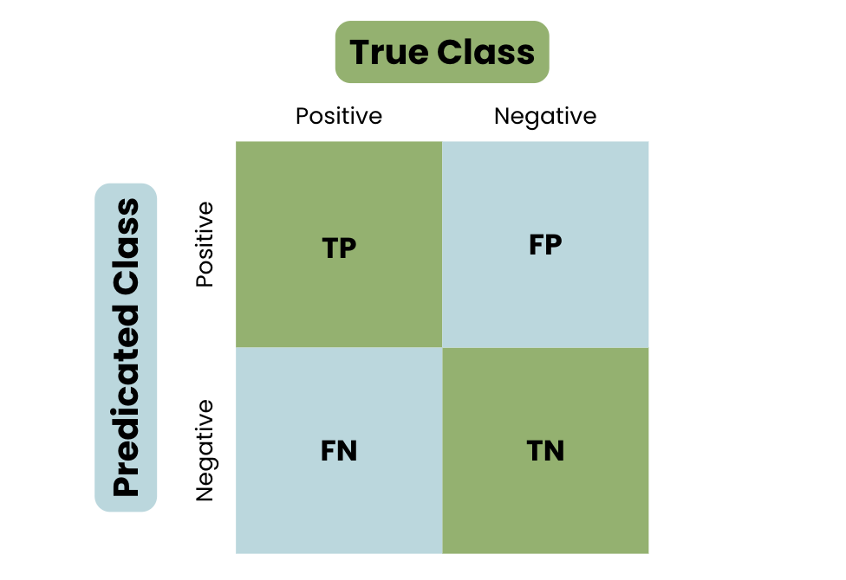
Classification method
Notes:
https://www.linkedin.com/pulse/100-open-source-big-data-ml-architecture-papers-sequel-anil-madan

Slide 9
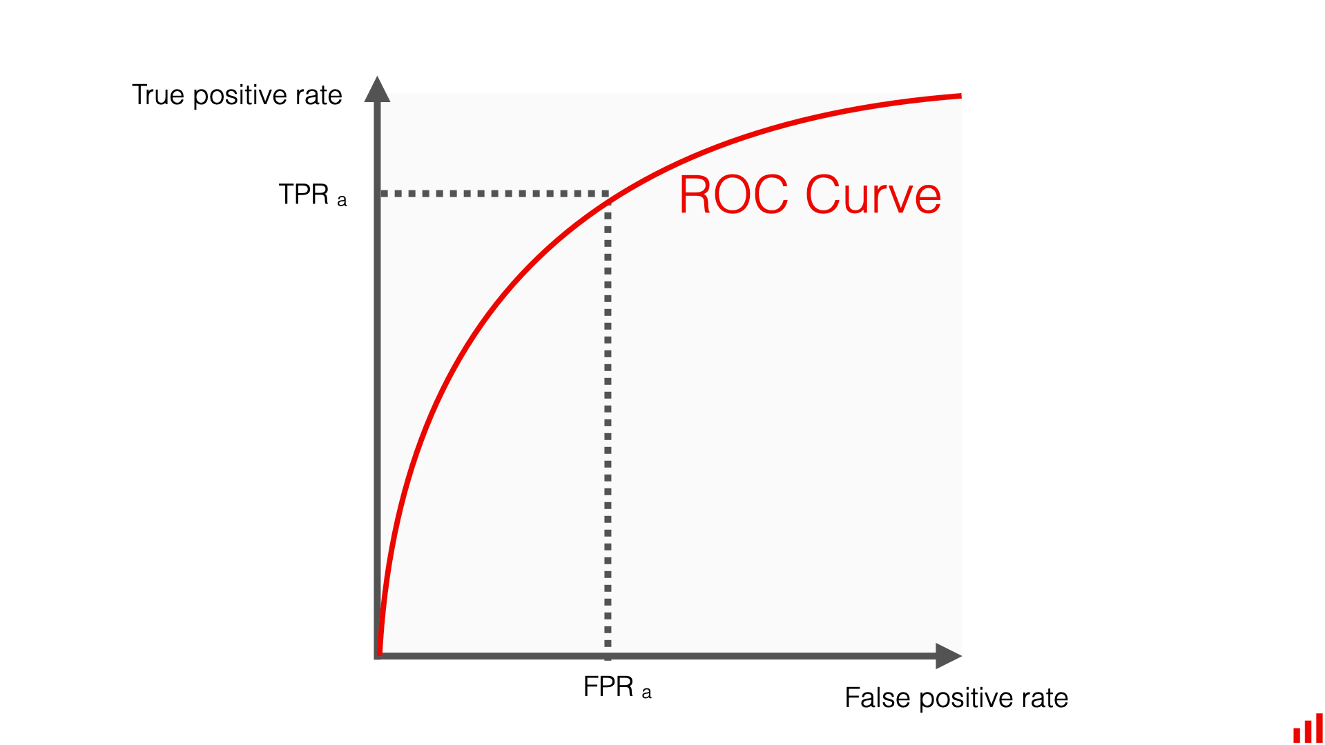
Classification method
Notes:
https://www.linkedin.com/pulse/100-open-source-big-data-ml-architecture-papers-sequel-anil-madan

